Slide 2
Republic Day 2017 at
Sankalp Centres

Slide 3
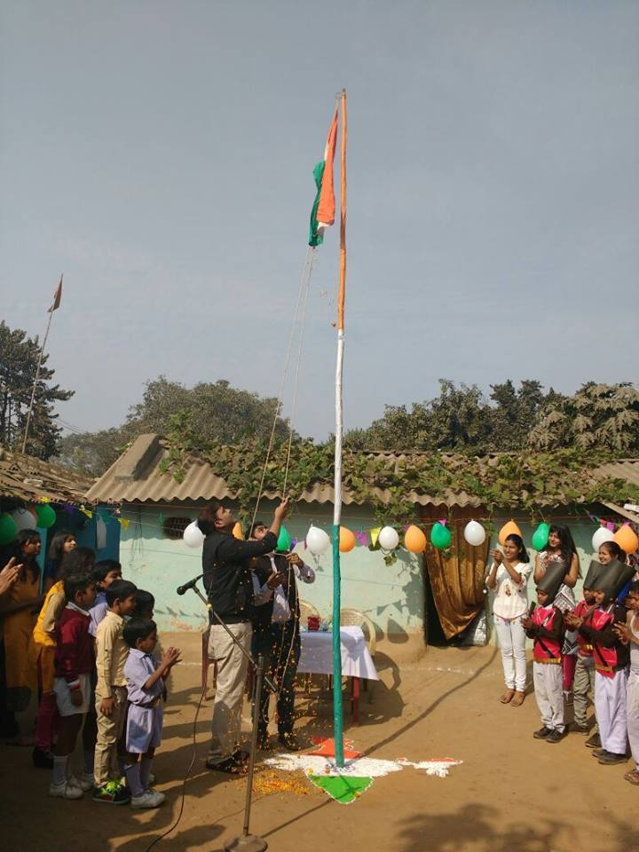
Where the mind is without fear
and
the head is held high........

Slide 5
Republic Day celebration
across
Sankalp Centres

Slide 6
Madhepura Centre
Gamharia
Bihar

Slide 7
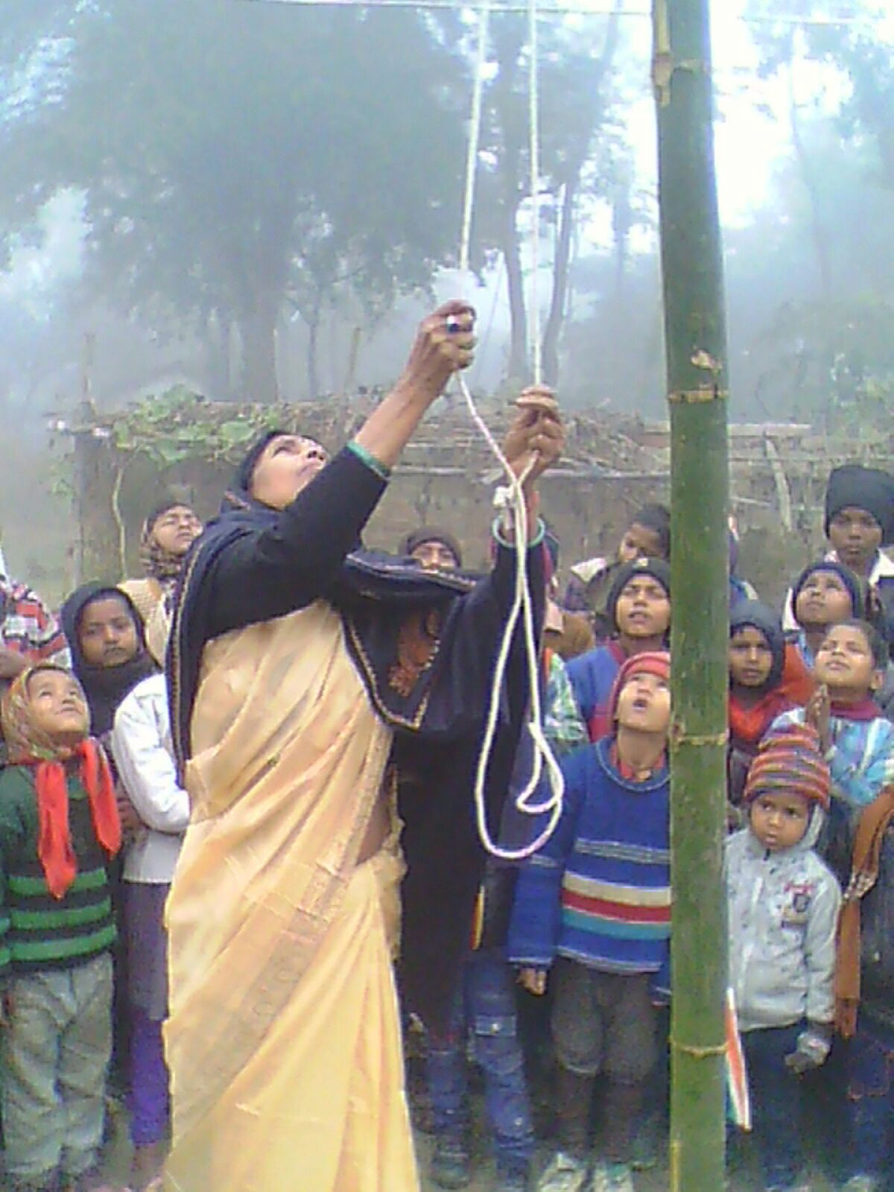
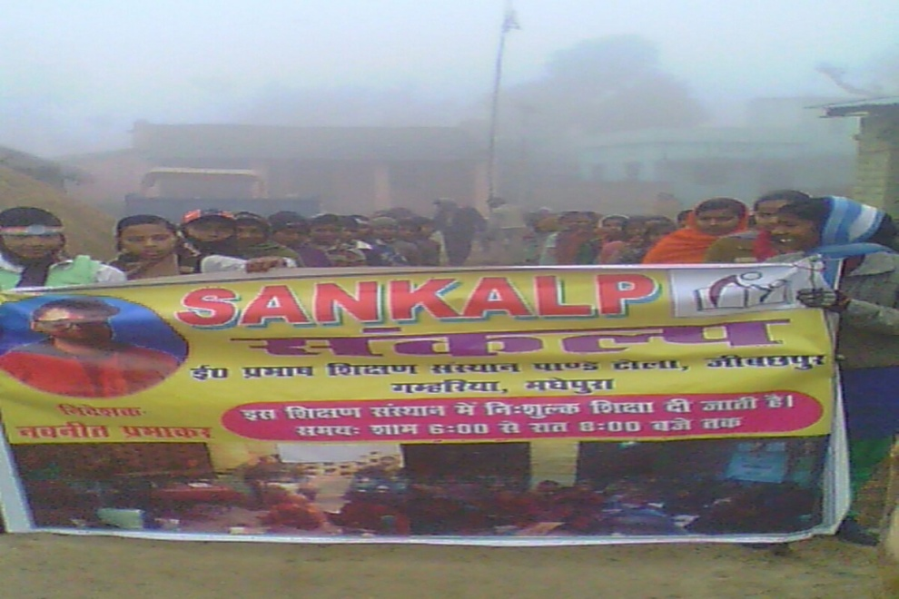
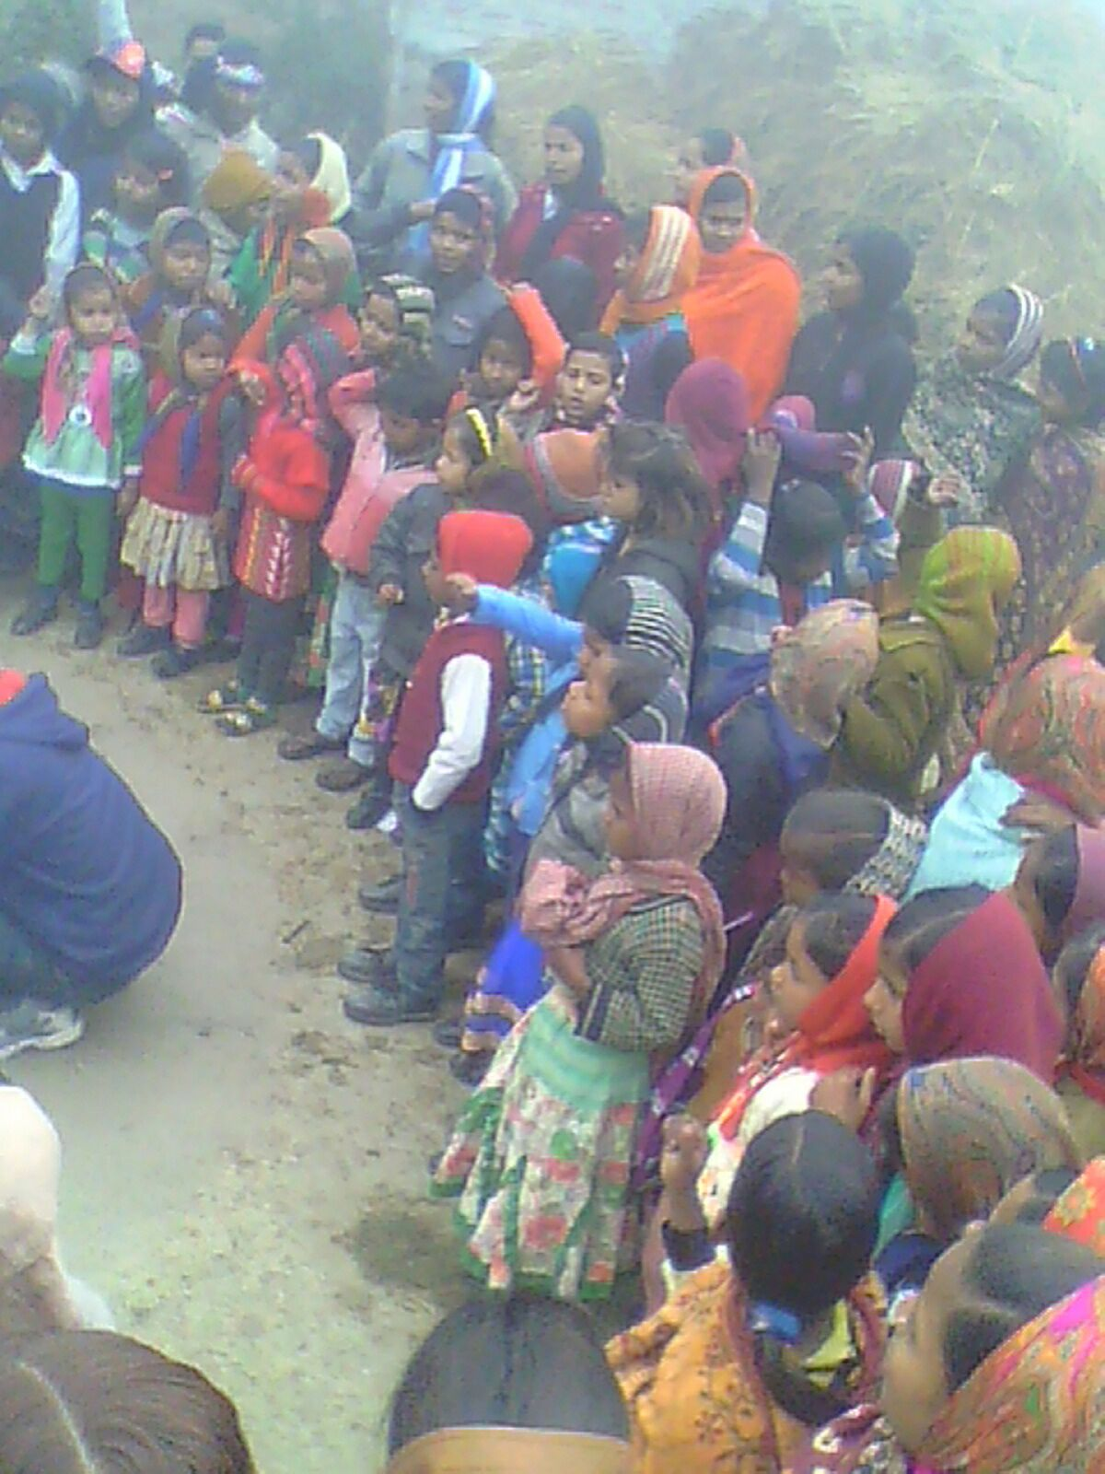

Slide 8
Dhanbad Centre
Kendua Block
Jharkhand

Slide 9
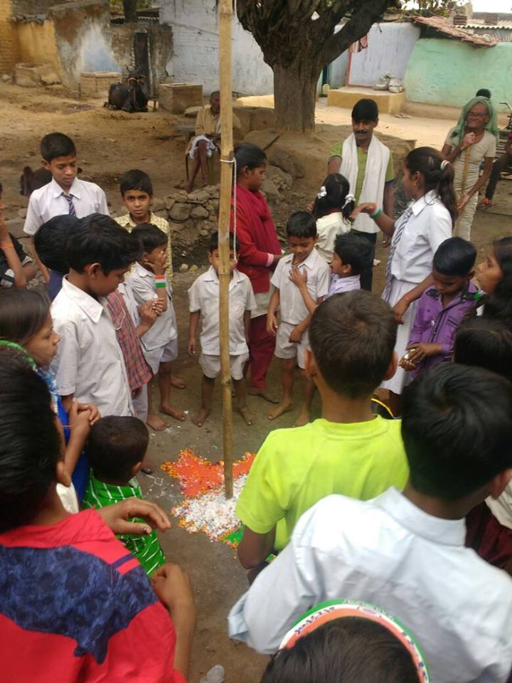
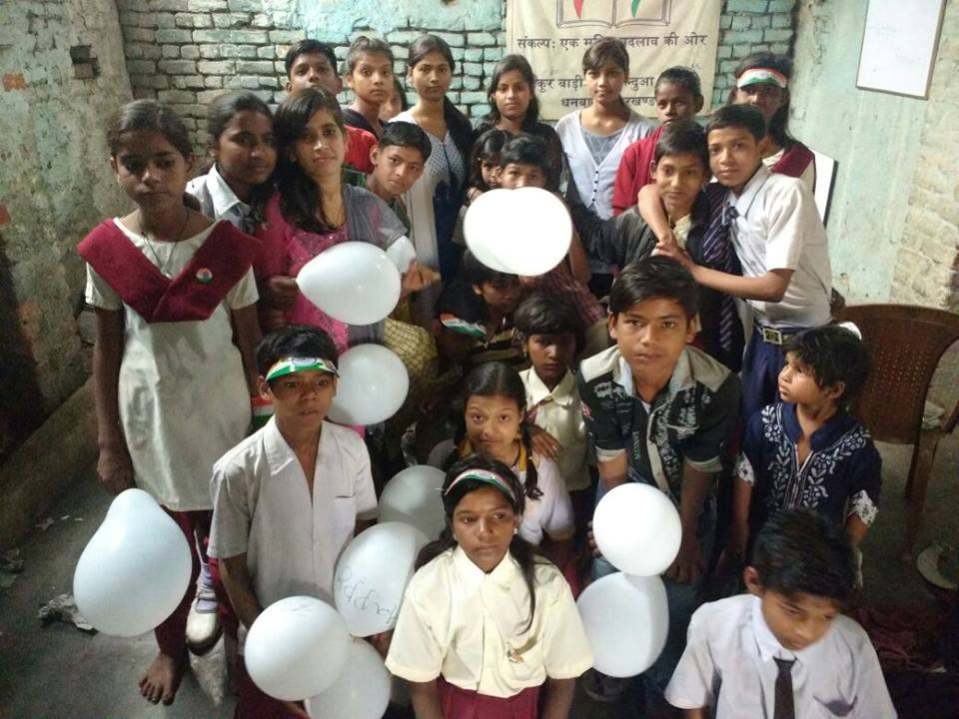
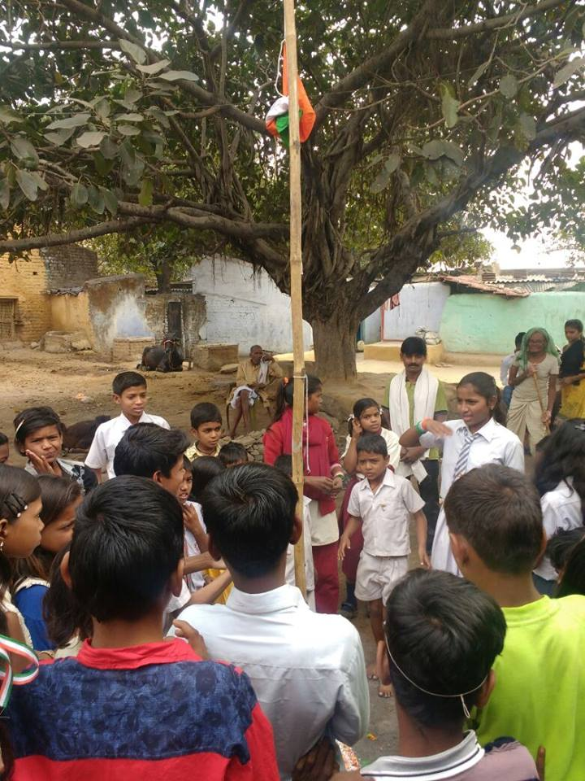

Slide 10
Adityapur Based Centres
Mohan Nagar, N.I.T., Imli Chauk,Navodaya & Aashiyana
Jharkhand

Slide 11
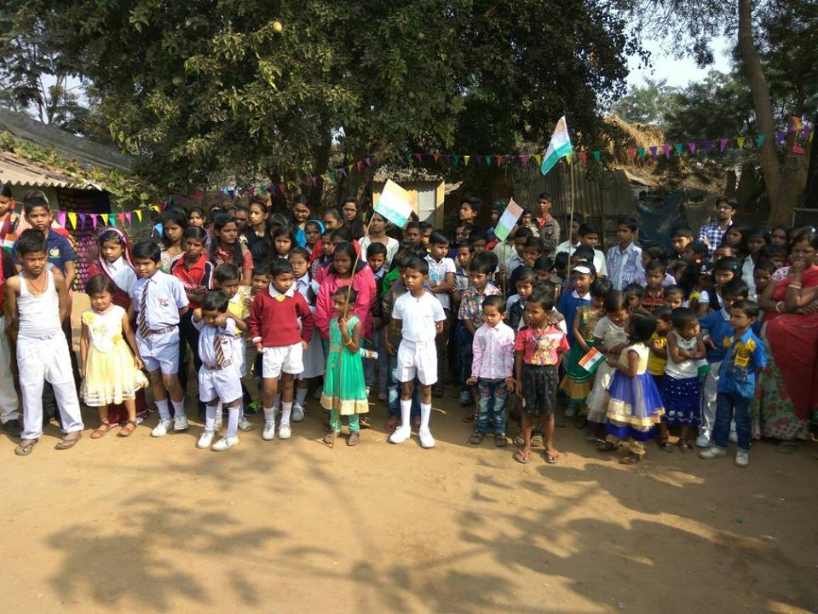

Slide 12
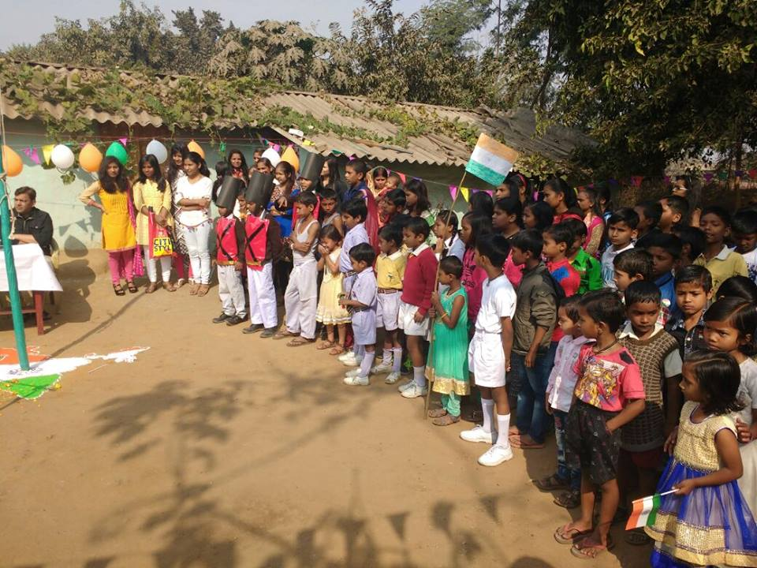

Slide 13
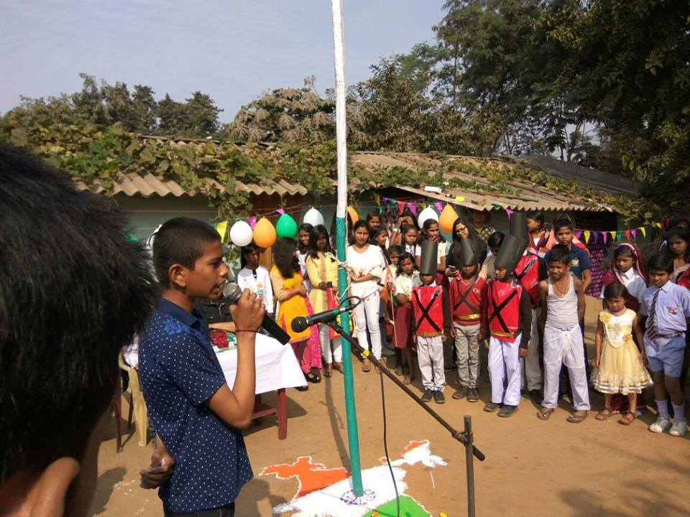
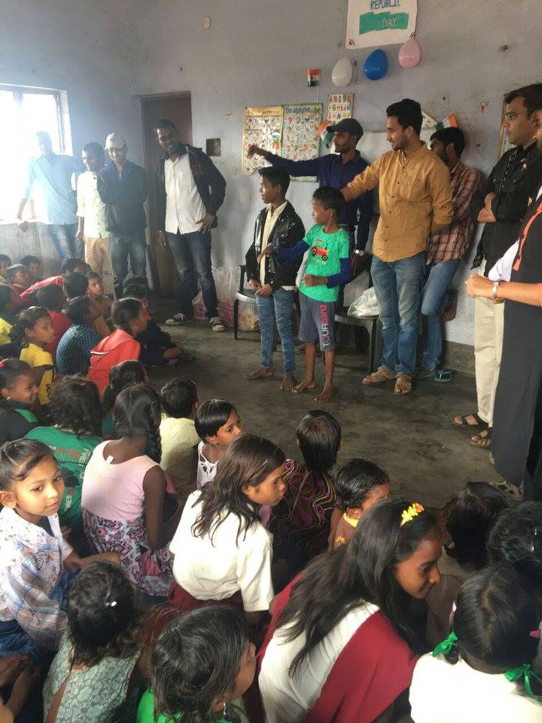
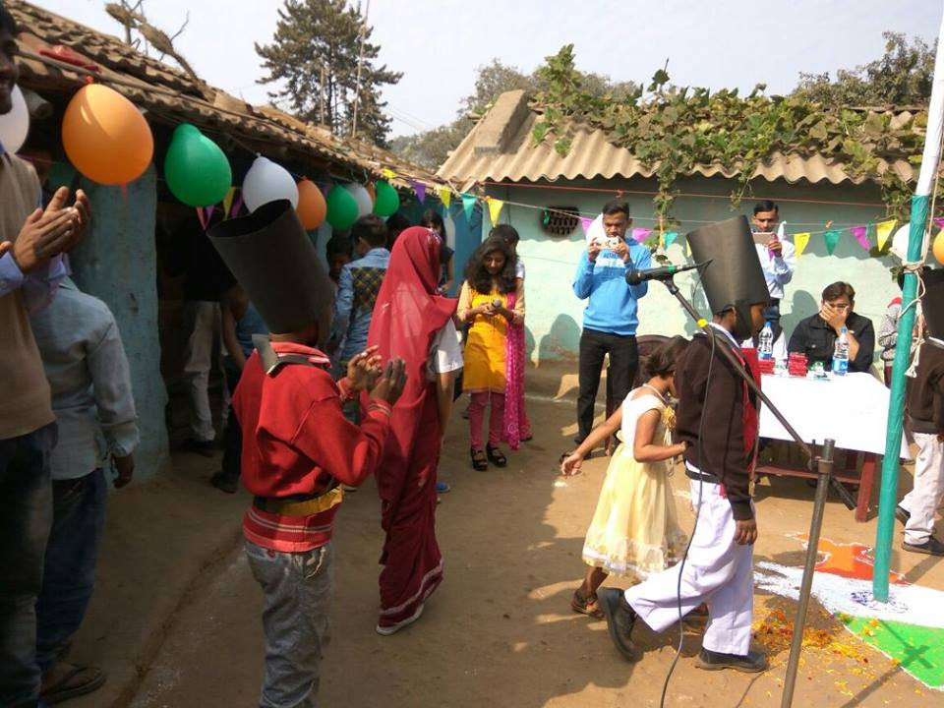
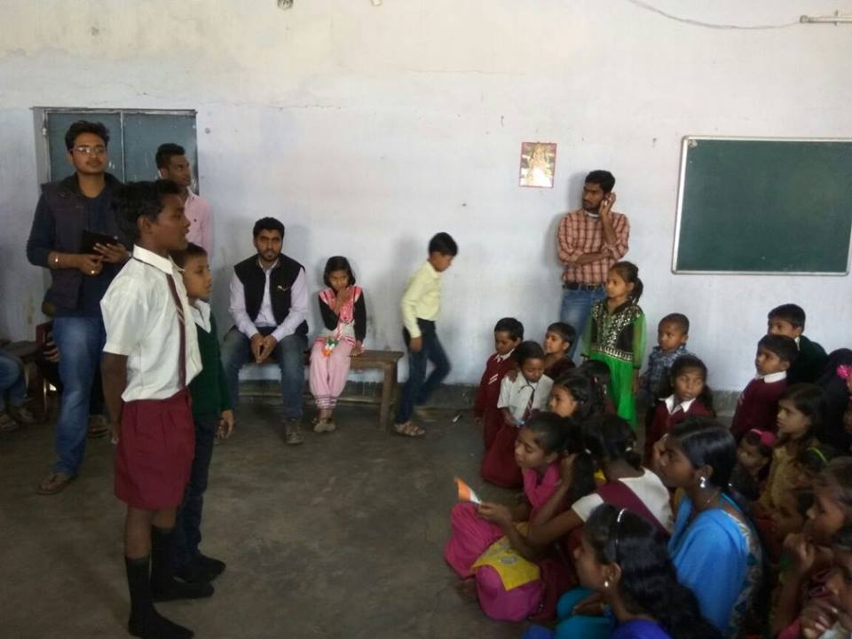

Slide 14
Giridih Centre
Sirsiya Block
Jharkhand

Slide 15
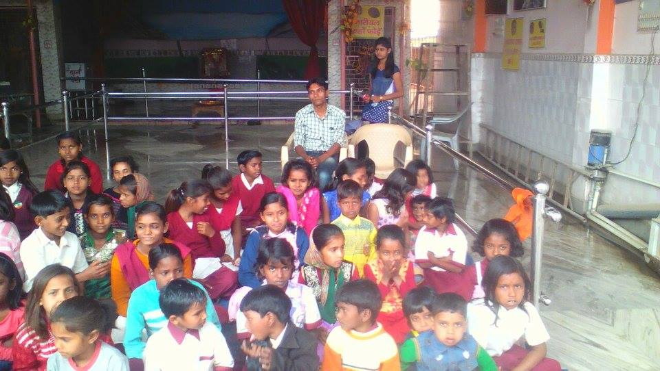
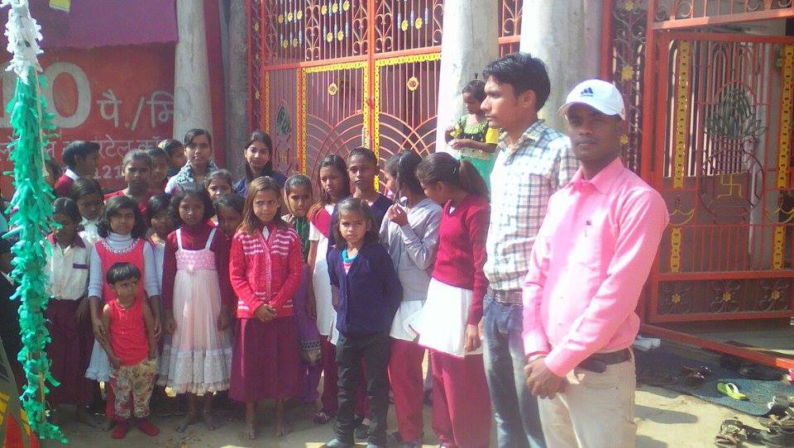
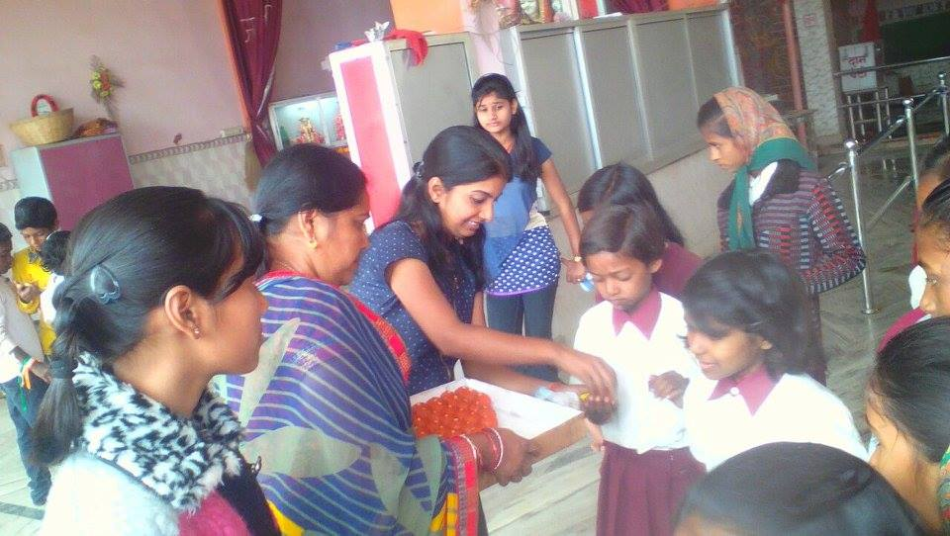
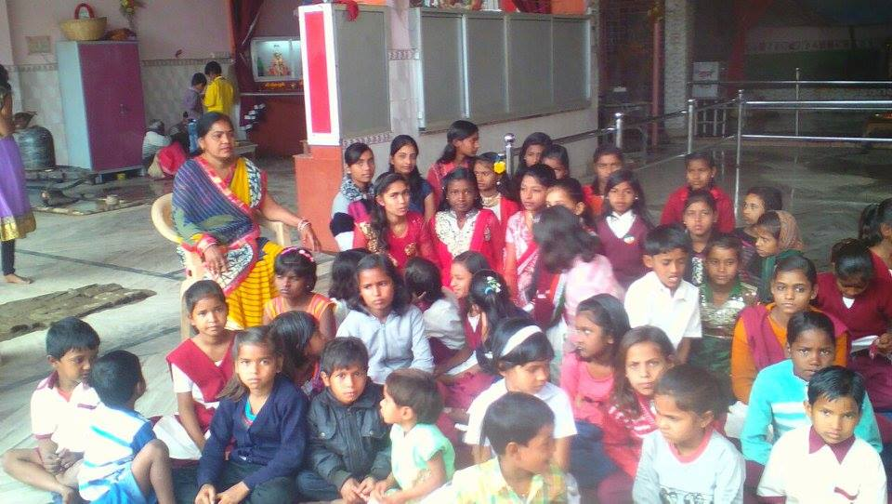

Slide 16
Navodaya Centre
Adityapur
Jharkhand

Slide 17
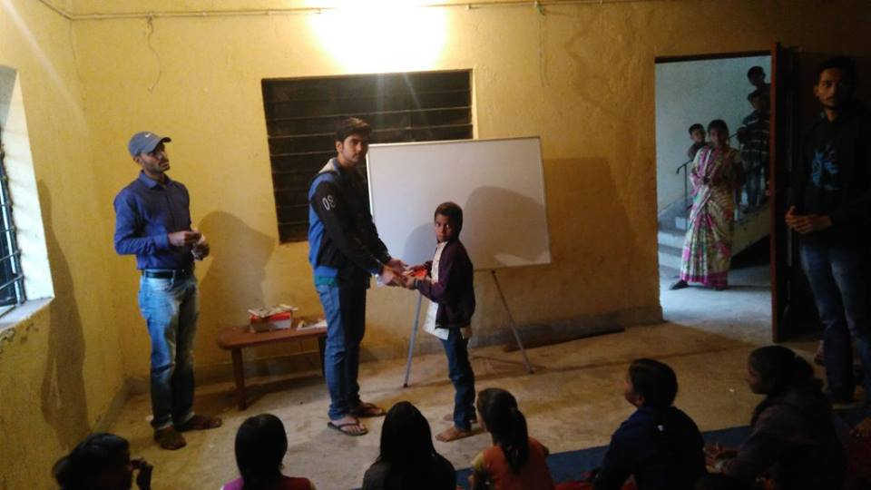
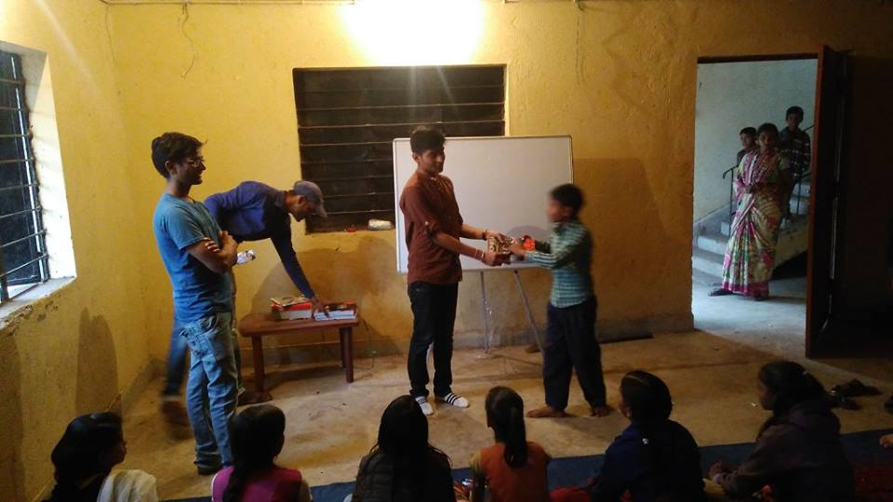
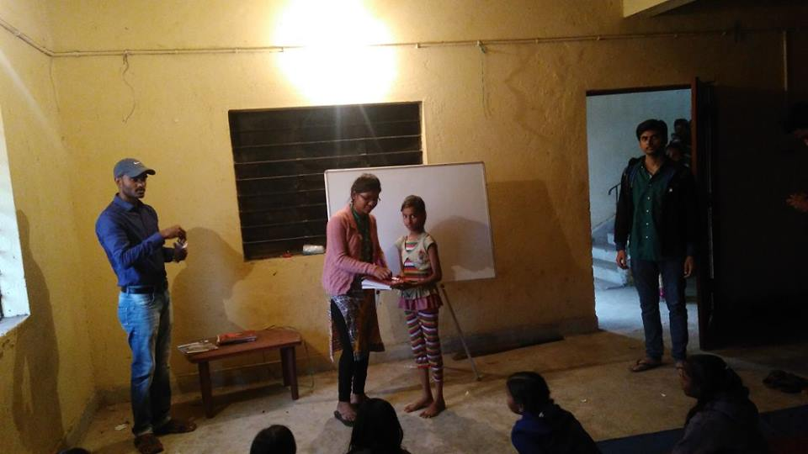
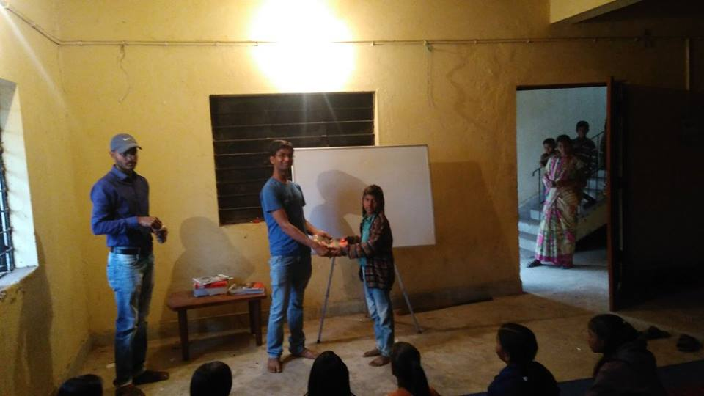

Slide 18
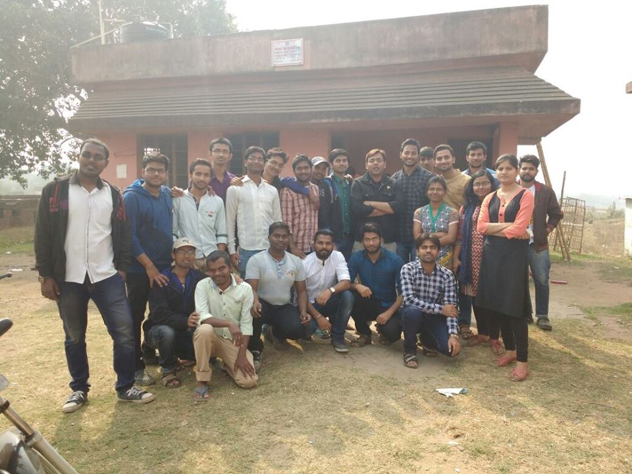

Slide 19
Into that heaven of Freedom
My Lord !!!
Let my Country awake

Slide 20
EASY WAY TO DONATE NOW
You can donate at any our centres by just making a call to Sankalp-A Pledge to Change volunteers.
All our centres run 6 days a week
You may donate books from
Class 1-8- Course Text Books (Any Board)
Story Books
Unused stationery
Any other items like bag, toys, uniforms etc.
Relevant Contact Nos. Are
Subodh Kumar Das-9798756336
Mayank Aggarwal -9031975746
Suresh Pareek -7209632032
Vikas Dixit -9472706225

Slide 21
ACCOUNT DETAILS FOR SUPPORT
Sankalp Account Details
You can transfer funds online into our account:-
“SANKALP” A/C No.-31114719936
CIF No: 85757412911
IFSC Code: SBIN0001882
MICR Code: 831002004
Branch code: (1882)
Branch: SBI- RIT JAMSHEDPUR
You may also visit our website and pay through online link available over it.
www.sankalpnitjamshedpur.org

Slide 22
“You have not lived today until you have done something for someone who can never repay you.”
Thank You
www.sankalpnitjamshedpur.org

